Slide 1

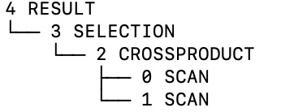
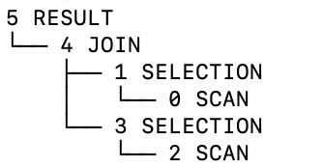
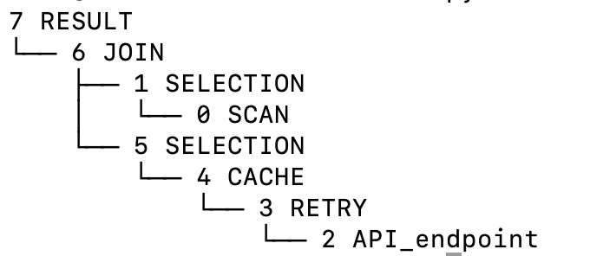
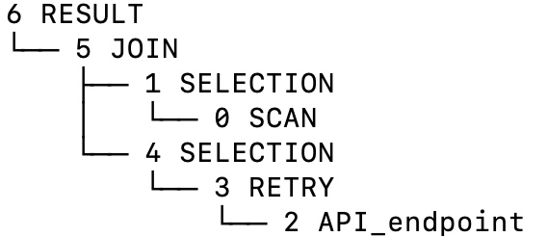
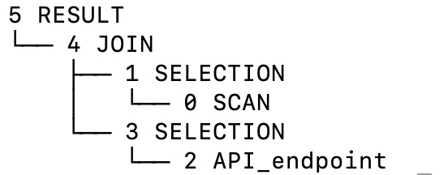
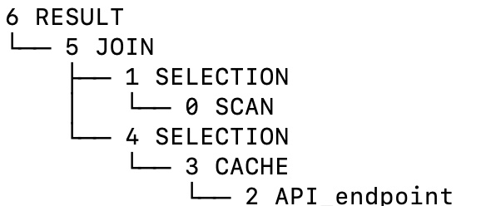
Towards a Declarative Support for Function APIs
Gustavo Frances, Mohammed Uwais
^{Mentor: Mohamed E. Khalefa}
SUNY Old Westbury, NY
j
k
Introduction
Solution Overview
Summary and Future Work
Implement a simple framework that supports files, and APIs end points.
Files can be in JSON or csv file
Generated schema may add extra fields to help reason about data
For example, schema for csv files is expended by row and column attributes
the plan is extended to handle nondeterministic errors and amortize function initialization and model loading.
The implementation is currently protype, more features can be added
Improving the efficiency of the system
Generate more optimized plans
Add cost-based optimization
Optimize memory management and buffer pool
Support caching to Key value stores, such as Redis
Make it easier to incorporate more API endpoint
Conduct performance experiments between the proposed system and other database system
.
With widespread availability of data and API libraries for complex tasks such as image, natural language processing
build powerful applications.
While Python packages provide an extensive library for these APIs, manually writing these application workflows that consume and/or invoke is a cumbersome task.
Optimizing such workflows is challenging,
due to the arbitrary cost model and inconspicuous relations among these functions.
We are proposing a declarative framework to generate optimized python code from a SQL-like query language framework, to enable
support heterogeneous data structures
avoids coupling function calls provided by the APIs,
hides the details of error handling, and user authentication, and call rate limits.
SQL
SQL Parser
∏
σ
⨯
⨯
σ
AST Optimizer
M
⨯
s
Screenshot for Plan before optimization
R
R
Implementation Details
∏
Declarative query framework
Implemented in python
Generated Code is in python.
Users can inspect the generated scripts and modify them as they see fit
AST Optimizer:
A simple rule-based query optimizer is implemented
a cost-based query is planned
API Optimizer:
use cache and memorization to avoid redundant calls
Add logic for retry function invocation
Initialize and finalize function call
Open file
Load cache in memory
API authentication
Code Generator:
currently support basic relational operator, selection, projection, join and crossproduct
Further, operator can be easily added to the framework
Advanced memory management and buffer allocation would be incorporated as a future work.
Code for each operator is generated in a separate function
Flexible schema support
Schema information is automatically deducted from the input files
Nested data may be flatten
σ
⋈
∏
⋈
σ
⋈
API Optimizer
M
R
R
σ
Screenshot for Plan after optimization
s
Acknowledgements:
We would like to thank our professors at SUNY college at Old Westbury, and special thanks to Prof. Ebrahimi and Prof. Betty Berbari for making it possible for us to be here today.
∏
σ
References:
Rompf, Tiark, and Nada Amin. "Functional pearl: a SQL to C compiler in 500 lines of code." Proceedings of the 20th ACM SIGPLAN International Conference on Functional Programming. 2015.
Tahboub, Ruby Y., Grégory M. Essertel, and Tiark Rompf. "How to architect a query compiler, revisited." Proceedings of the 2018 International Conference on Management of Data. 2018.
Scully, Ziv, and Adam Chlipala. "A program optimization for automatic database result caching." Proceedings of the 44th ACM SIGPLAN Symposium on Principles of Programming Languages. 2017..
⋈
⋈
∏
σ
⋈
Screenshot for Plan with
cache and retry
Screenshot for Plan with retry
M
R
R
σ
Code Generator
Cache
s
Retry
Screenshot for a plan with
no caching and retry
Screenshot for Plan with caching
Python Script
Funding:
Project is partially funded by NSF CISE-MSI: AWARD #2131052

